Slide 1
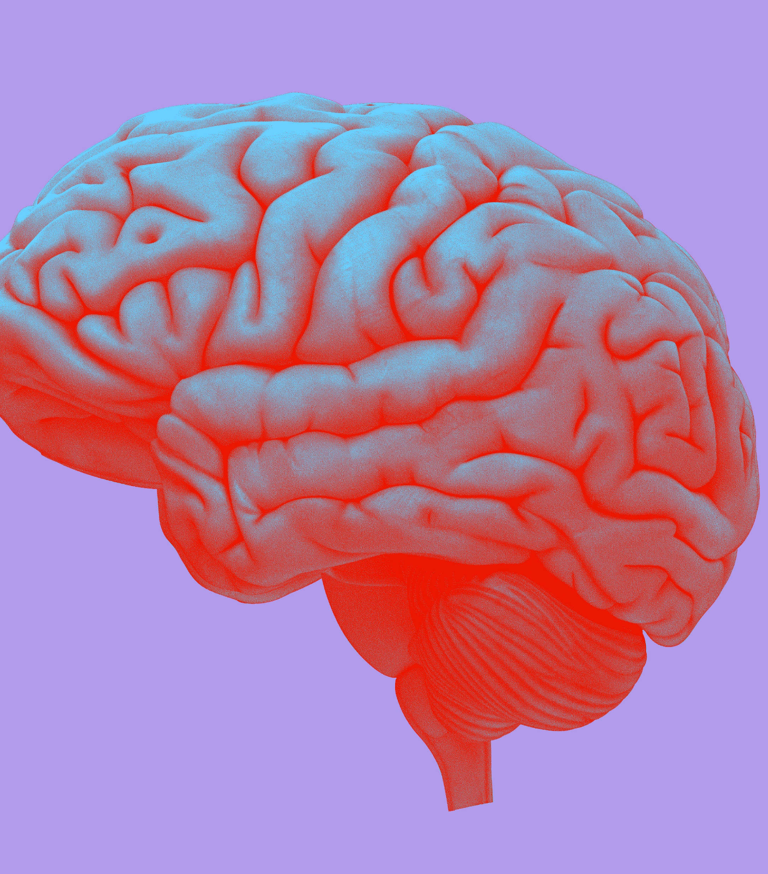
UK Minds Biomarker (SomaLogic) QC and Analysis​
Paul Donovan, PhD
Kevin Blighe, PhD
Brad Farrell, Project Manager, MS, PMP
18 June, 2024

Slide 2
SomaLogic QC

Slide 3
SomaLogic QC
PCA – identify samples with extreme values, odd profiles
Investigate sample basic stats
Investigate somamer basic stats
Generate metrics for filtering:
Estimated Limit of Detection (eLOD) if unavailable (e.g. Median + 3* MAD)
Scale factor (i.e. find odd somamers)
Coefficient of Variation (CV) of calibrators (i.e. find odd somamers)
Investigate somamer distributions (test modalities of somamers)
Apply filters on newly generated metrics
Transform/Scale (optional)
Generate summary statistics
Write to file

Slide 4
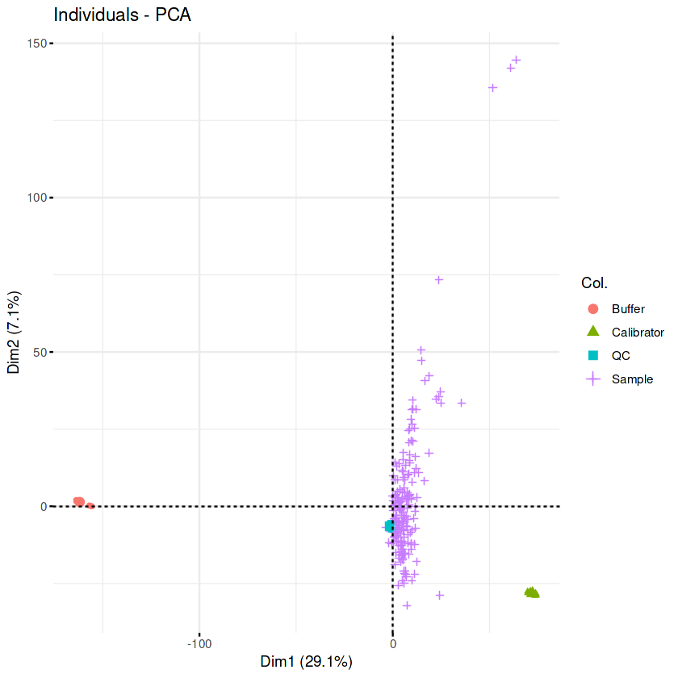
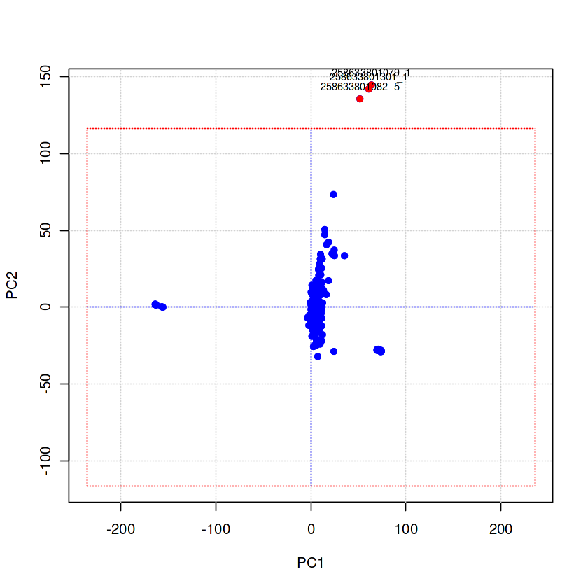
SomaLogic QC - PCA
Outlier samples:
258633801079_1
258633801082_5
258633801301_1
Colored by group
Identify samples outside 5 standard deviations

Slide 5
SomaLogic QC – Summary
 | # in pre-QC | # removed | # in post-QC
Samples | 224 | 3 | 221
Somamers | 7596 | 764 | 6804
Post-QC sample breakdown
Buffer, 15
Calibrator, 15
QC, 9
Sample, 182

Slide 6
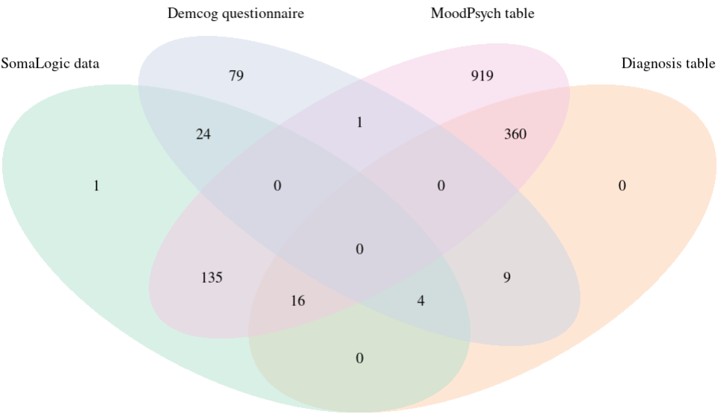
SomaLogic QC
Subset Somalogic data to the samples that have metadata
Of the 185 samples that are labelled 'Sample' (as opposed to QC, Calibrator or Buffer), 5 of these are named 'QC' in the 'pni_id' column.
Of the 180 samples we have Somalogic data for, we mapped ​​
28 of these to the Akrivia demcog (questionnaire) table​​
20 of these to the Akrivia diagnosis table​​
151 of these to the Akrivia moodpsych table​
Demcog data relates to dementia patients, whereas the moodpsych questionnare is the baseline assessment administered to the mood disorder patients (MDD, bipolar, schizophrenia)
There is no single consensus table containing diagnoses or metadata for all samples.
Database as of 30 April 2024 (no change to SomaLogic intersections as of 04 June 2024)

Slide 7
SomaLogic QC
Of the 180 samples we have Somalogic data for, we moved forward using the MoodPsych (n=151) and Demcog sample mappings (n=28).
We used the 'moodpsychosis_diagnosis_main' column from the moodpsych questionnaire table to label mood disorder samples, dropping all groups with fewer than n=15.
The most abundant group based on self-reported diagnoses from the demcog table contained only 8 samples. We labelled all demcog samples as 'Dementia' after getting Gayle Wittenberg's approval for this action.
After removal of failed QC, and moodpsych samples with non-standard diagnoses, the final sample count was 154
After QC, the final somamer count was 6,804
Database as of 30 April 2024 (no change to SomaLogic intersections as of 04 June 2024)
 | # Samples
Depression | 77
Bipolar | 35
Schizophrenia | 15
Dementia | 27

Slide 8
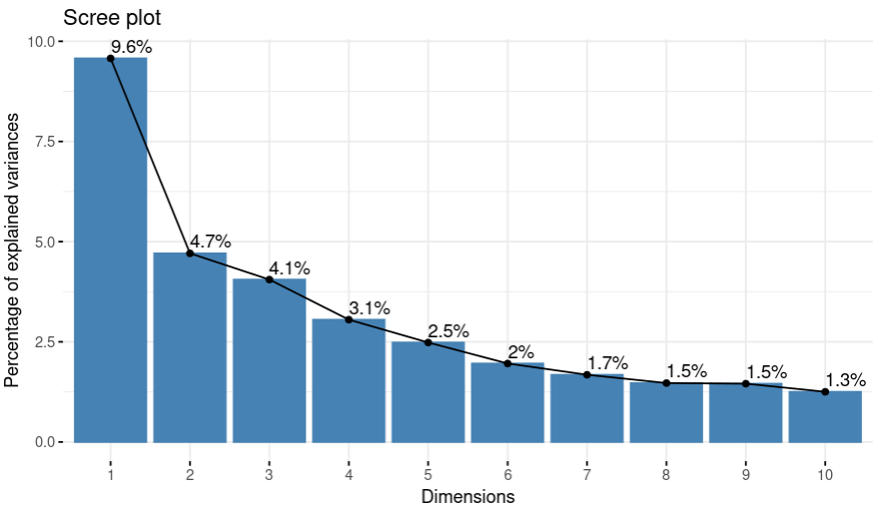
SomaLogic QC
Somalogic data (154 samples, 6,804 somamers)

Slide 9
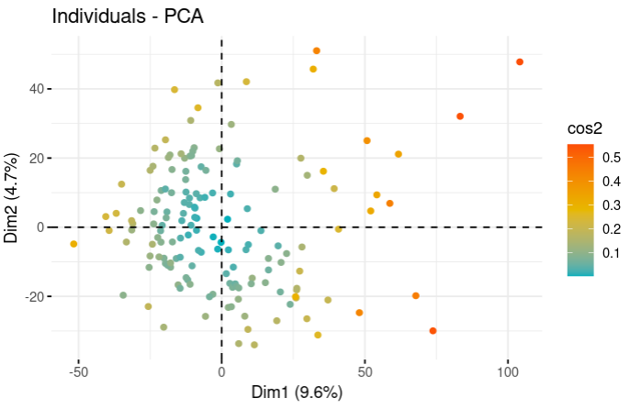
SomaLogic QC
Somalogic data (154 samples, 6,804 somamers)

Slide 10
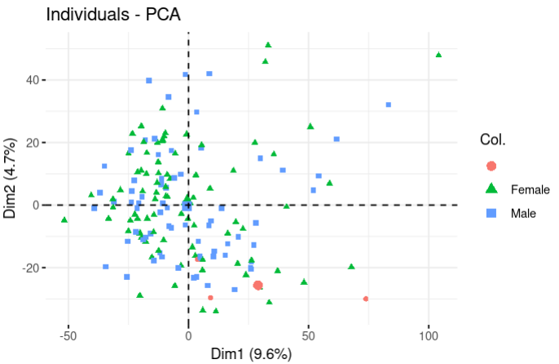
SomaLogic QC
Somalogic data (154 samples, 6,804 somamers)

Slide 11
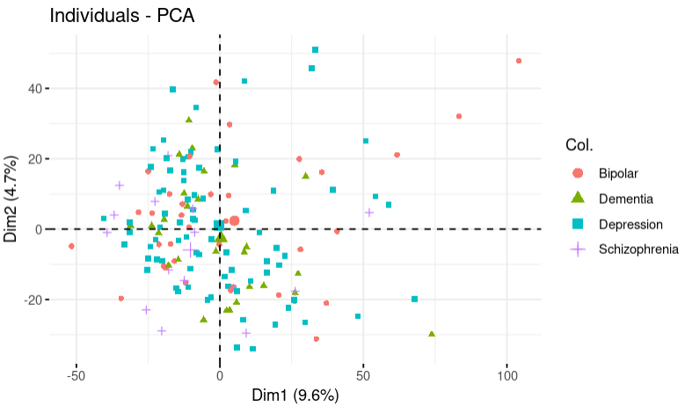
SomaLogic QC
Somalogic data (154 samples, 6,804 somamers)

Slide 12
SomaLogic Analysis ['Insights']

Slide 13
SomaLogic Insights
Differences in protein abundances across dementia, MDD, bipolar, schizophrenia
ANOVA
Pairwise comparisons
Protein enrichments
Clustering / Dimension Reduction
Supervised + Unsupervised hierarchical clustering
PCA, tSNE, UMAP
RandomForest classifier to build model to predict dementia, MDD, bipolar, schizophrenia
Model training and parameter fine-tuning
Model predictions on validation data + performance metrics

Slide 14
1.1 Differential Protein Abundance Analysis

Slide 15
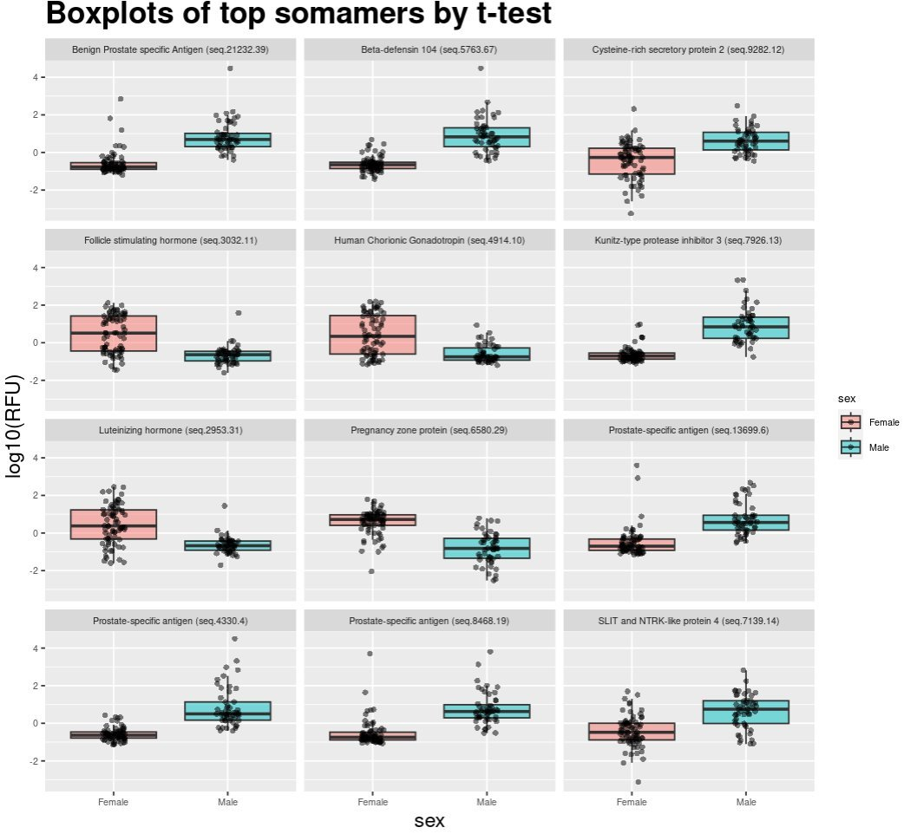
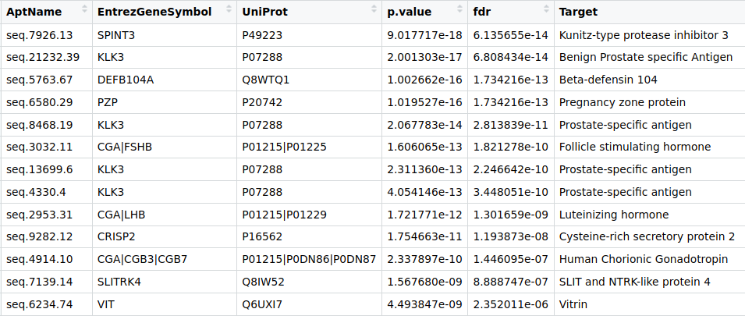
T-test using Sex as variable of interest
Sanity-check data by analyzing sex using t-test
F=74
M=54
This resulted in 115 somamers with fdr<0.05
Vast majority of top somamers are sex-related
(results generated previously using moodpsych/mood disorder samples only)

Slide 16
Pre-processing for ANOVA analysing diagnosis
We are interested in differences related to self-reported diagnoses
154 samples and 6804 somamers in total
11/154 samples had no age, so we calculated using 2023 minus year of birth.
Three samples had no sex. We dropped these leaving us with n=151

Slide 17
Pre-processing for ANOVA
Our ANOVA model includes two covariates (sex and age group)
design model = somamer ~ diagnosis + sex + age_group
Sex (F=82, M=69)
AgeGroup
0-32 = 21
33-65 = 92
66-100 = 38
After pre-processing, we have 151 samples and 6804 somamers in total

Slide 18
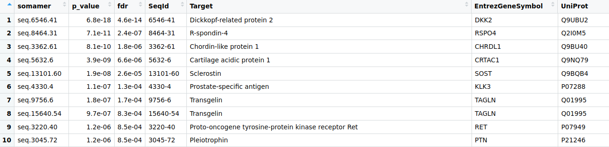
ANOVA results
Top 10 ANOVA somamers:
157 somamers with FDR<0.05

Slide 19
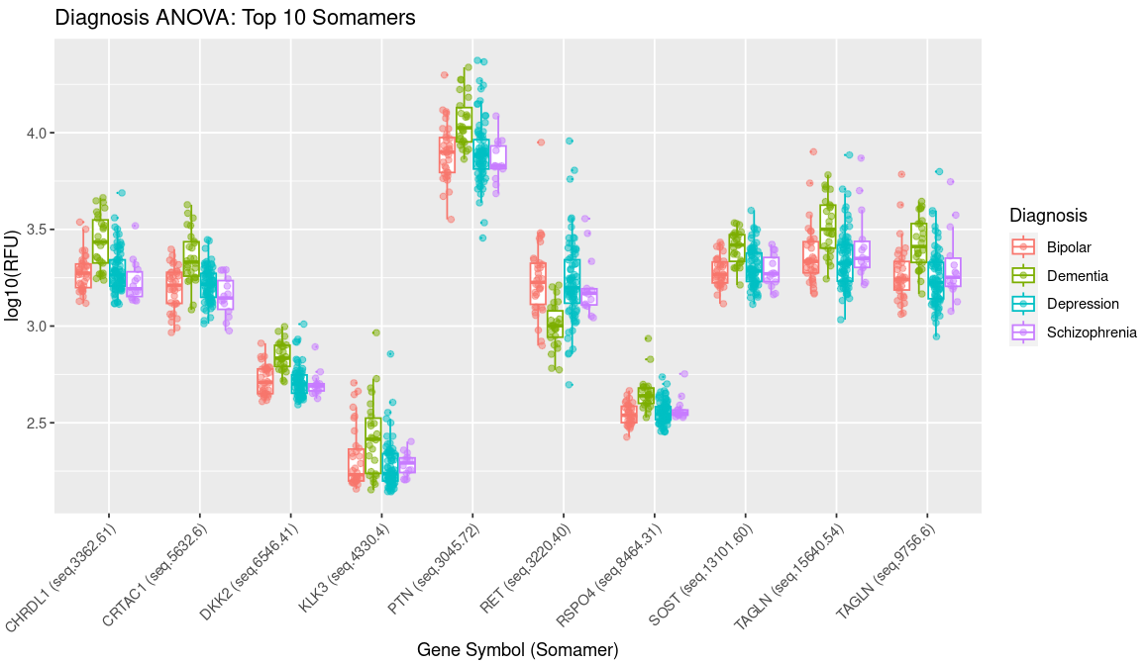
ANOVA results – Top 10 Somamers
Boxplots of top 10 ANOVA somamers.

Slide 20
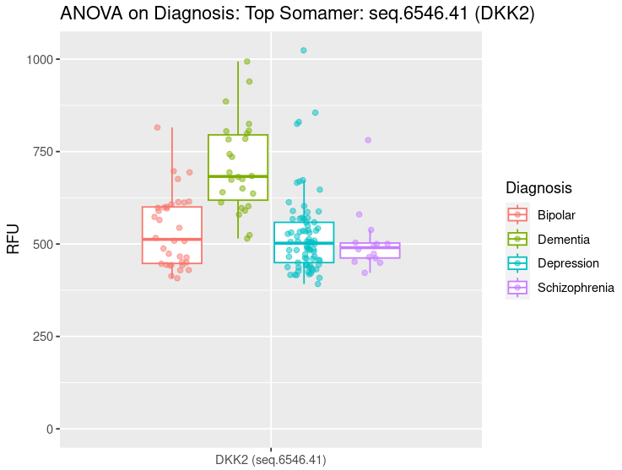
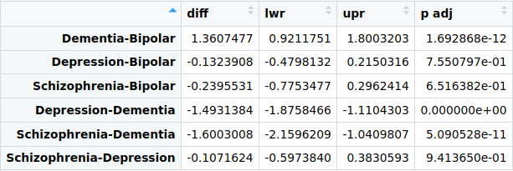
ANOVA results – Top Somamer (seq.6546.41, DKK2)
Top ANOVA somamer = seq.6546.41 (DKK2)
ANOVA FDR = 4.6e-14
Tukey's test:

Slide 21
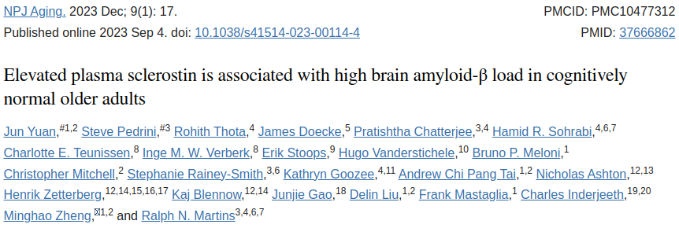
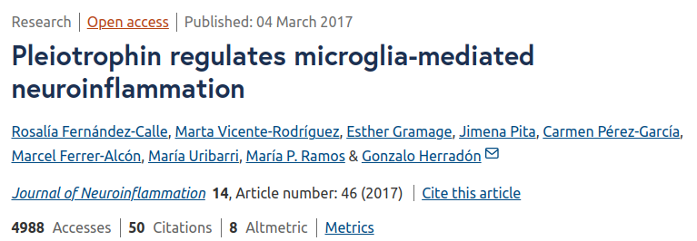
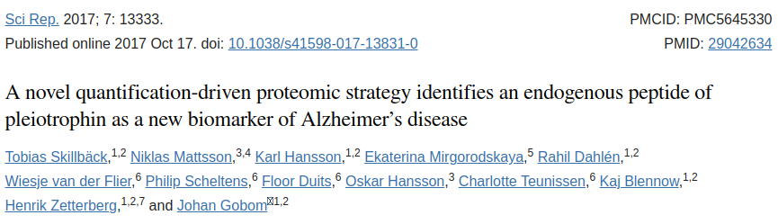
ANOVA results
Key findings:
DKK2
Homolog of DKK1 which is heavily implicated in AD pathogenesis (link)
SOST
Higher in dementia
Associated with high amyloid-B load (link)
TAGLN
Higher in dementia
Upregulated in AD amygdala (link)
PTN
Higher in dementia
Pleiotrophin is a cytokine that is highly upregulated in AD and others (link)

Slide 22
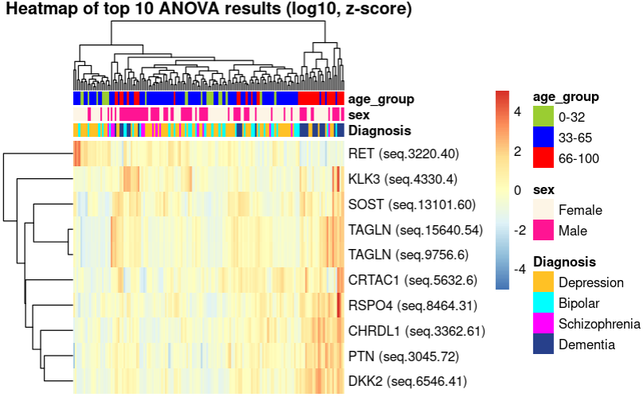
ANOVA results – Top 10 Somamers
Top 10 ANOVA somamers. Older samples and Dementia samples group on right of heatmap

Slide 23
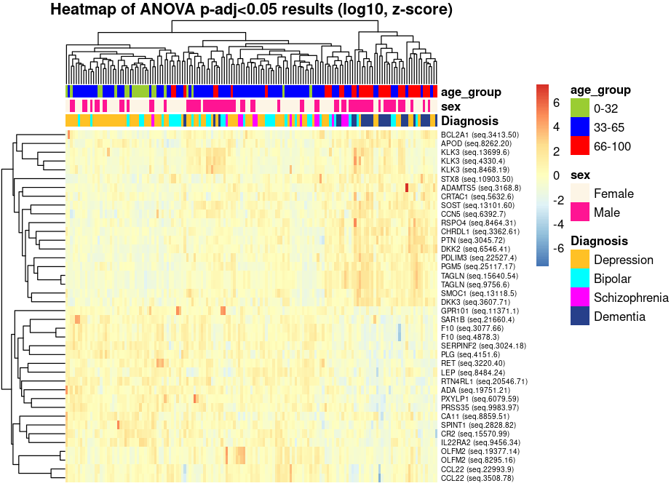
ANOVA
We generated a heatmap including all somamers with FDR < 0.05
Multiple examples of sets of somamers grouping together (e.g. KLK3, OLFM2).
Older samples and Dementia samples group on right of heatmap

Slide 24
1.2 Pairwise comparisons

Slide 25
Pairwise comparisons using linear regression
In addition to ANOVA, we performed pairwise comparisons between Bipolar, Depression, Schizophrenia, and Dementia samples.
Linear model = somamer ~ diagnosis + sex + age_group

Slide 26
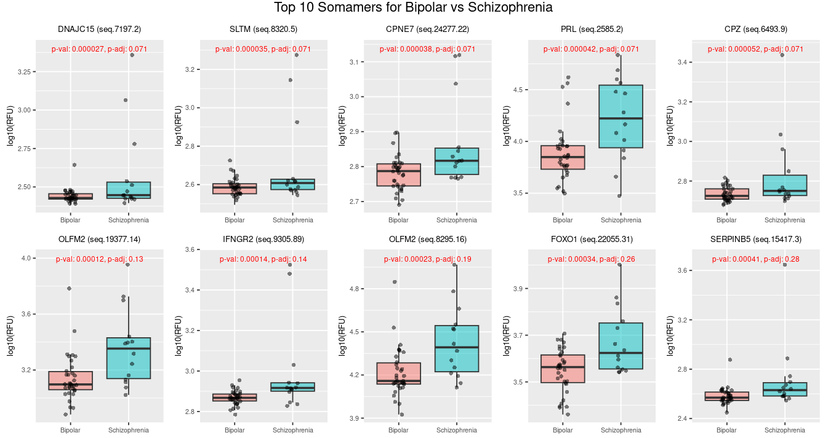
Pairwise comparisons – Bipolar vs Schizophrenia

Slide 27
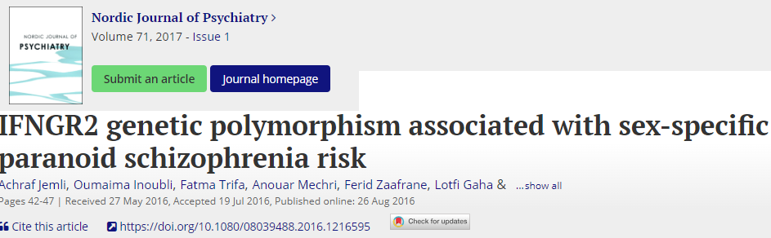

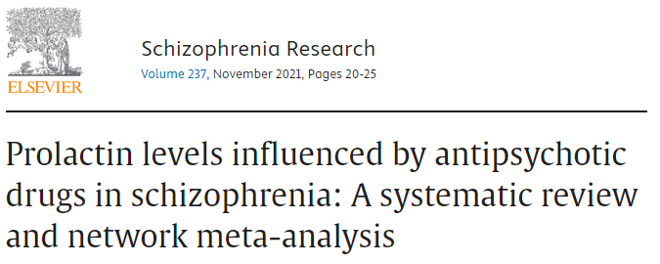
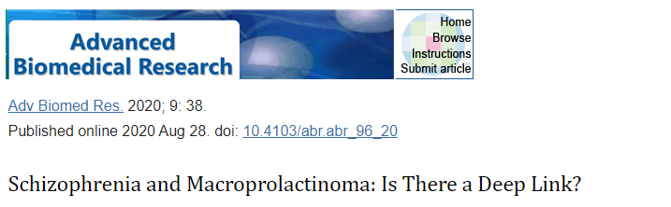
Pairwise comparisons – Bipolar vs Schizophrenia
Key findings:
IFNGR2
p-adj<0.05
Higher in Schizophrenia
Genetic mutation previously associated with sex-specific Schizophrenia (https://pubmed.ncbi.nlm.nih.gov/27563937/)
PRL (Prolactin)
p<0.0001
Higher in Schizophrenia
Strong literature association with Schizophrenia
https://www.ncbi.nlm.nih.gov/pmc/articles/PMC3985293/
https://pubmed.ncbi.nlm.nih.gov/34481200/
https://www.ncbi.nlm.nih.gov/pmc/articles/PMC7532829/

Slide 28
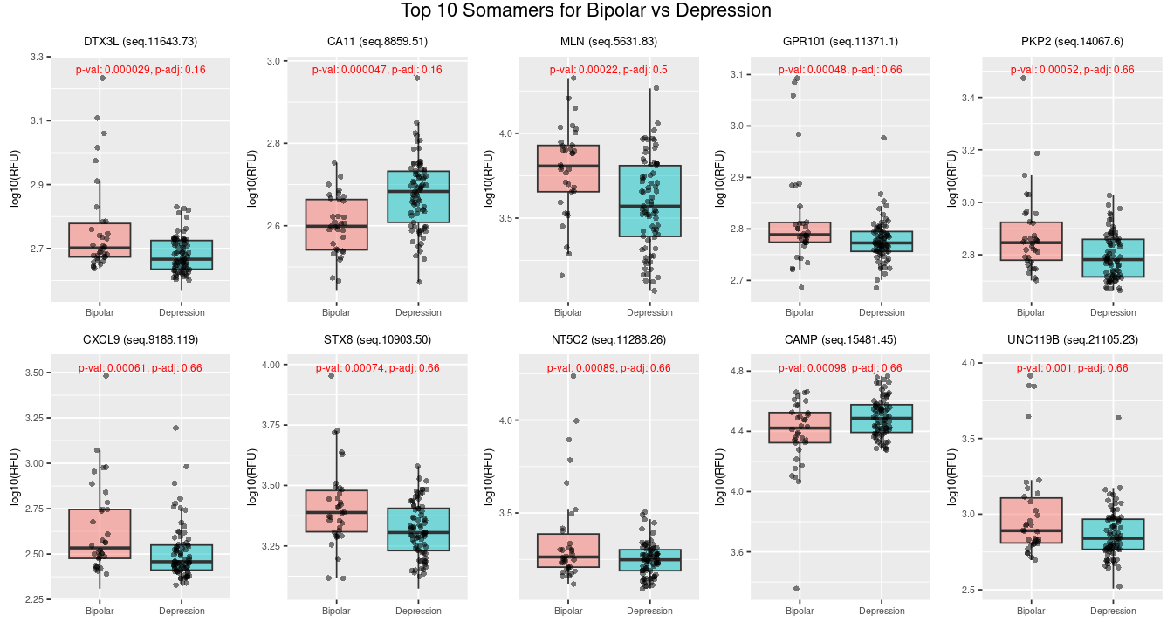
Pairwise comparisons – Bipolar vs Depression

Slide 29
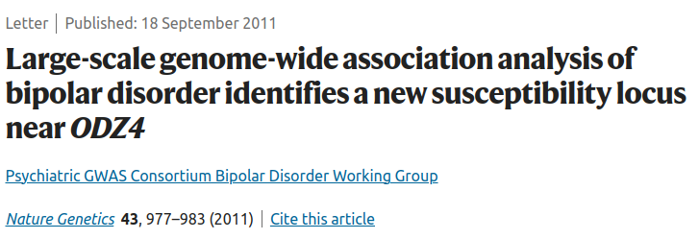
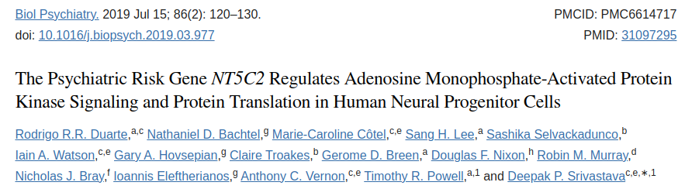
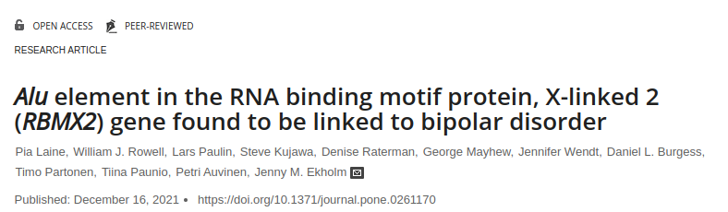
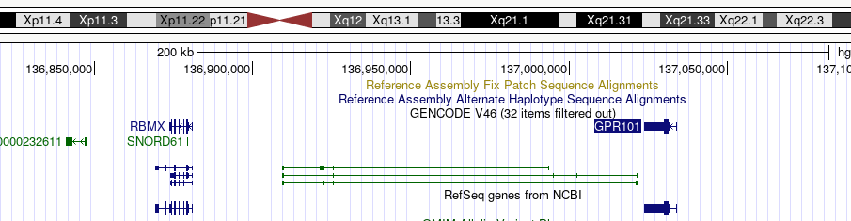
Pairwise comparisons – Bipolar vs Depression
Key findings:
CA11
p=0.000019
Bipolar GWAS association in locus near CA11 (https://www.ncbi.nlm.nih.gov/pmc/articles/PMC3637176/)
DTX3L
p=0.00003
Differentially expressed when comparing Schizophrenia to Bipolar (https://www.ncbi.nlm.nih.gov/pmc/articles/PMC5871764/)
NT5C2 linked to psychiatric disorders
GPR101 neighbors the RBMX gene with a tandem deletion found between these genes linked to Bipolar disorder. (https://pubmed.ncbi.nlm.nih.gov/34914762/)

Slide 30
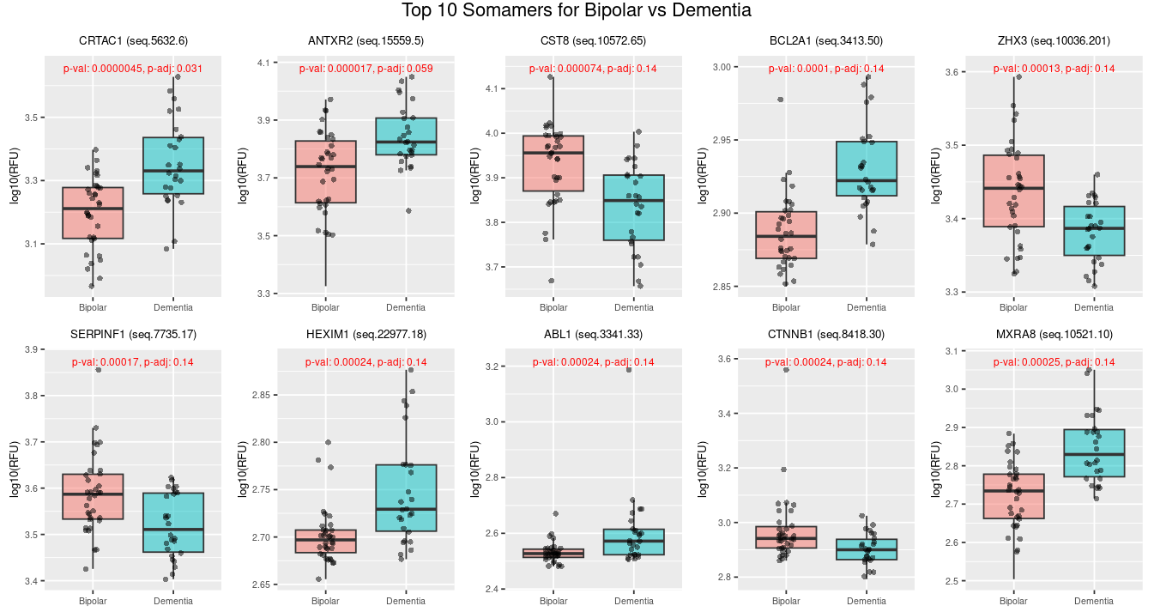
Pairwise comparisons – Bipolar vs Dementia

Slide 31
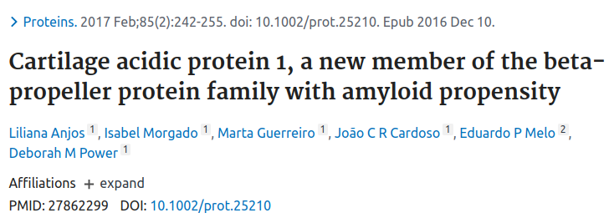
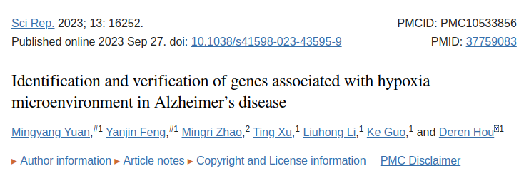
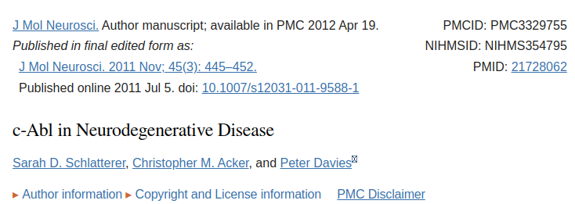
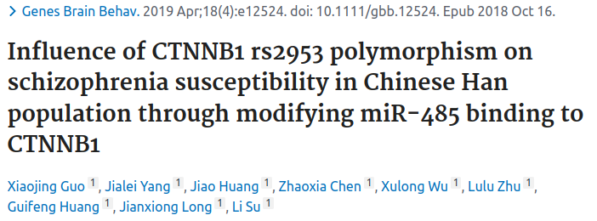
Pairwise comparisons – Bipolar vs Dementia
Key findings:
CRTAC1 - Forms amyloid-like aggregates
ANTXR2 - Related to pathogenesis of Alzheimer's Disease
ABL1
Involved in development of CNS
"Recent studies have shown c-Abl activation in human Alzheimer's and Parkinson's diseases and c-Abl activation in mouse models and neuronal culture in response to amyloid beta fibrils and oxidative stress. Overexpression of active c-Abl in adult mouse neurons results in neurodegeneration and neuroinflammation"
CTNNB1
"CTNNB1 encodes beta-catenin, an important protein in canonical Wnt signaling."
"The mRNA expression level of CTNNB1 significantly increased in the SCZ and BD groups compared with that in the control group."
"The mRNA expression of CTNNB1 can be used as a biomarker for the diagnosis of SCZ and BD."
MXRA8 - Matrix-remodelling associated protein. Abundance correlates with FTD (link). Increased abundance in mouse neuron-derived exosomes (link).

Slide 32
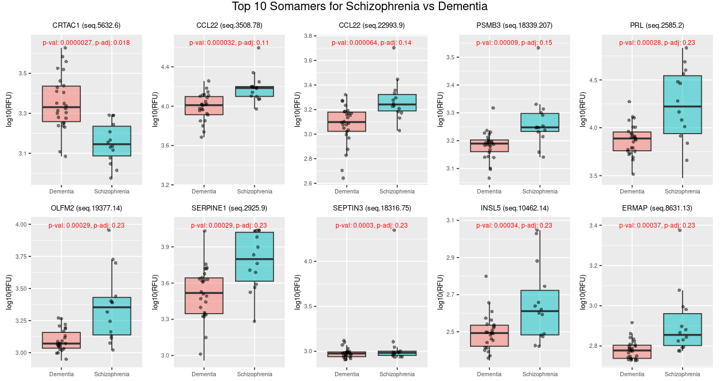
Pairwise comparisons – Schizophrenia vs Dementia

Slide 33
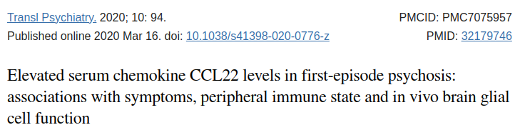
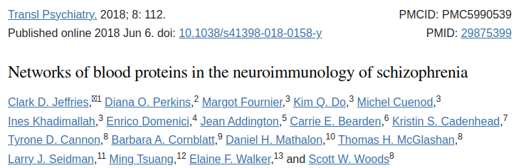
Pairwise comparisons – Schizophrenia vs Dementia
Key findings:
CCL22
Increased in Schizophrenia
Elevated serum CCL22 levels were significantly associated with hallucinations and disorganization, and with worse verbal performance in Schizophrenia patients (link)
SERPINE1
Increased in Schizophrenia
Protease inhibitor involved in regulation of fibrinolysis
"schizophrenia patients are subject to increased risk of cardiovascular disease, reduced risk of certain types of cancer, and possibly some aspects of accelerated aging; all these general observations have in turn been associated with SERPINE1 or related proteins" (link)

Slide 34
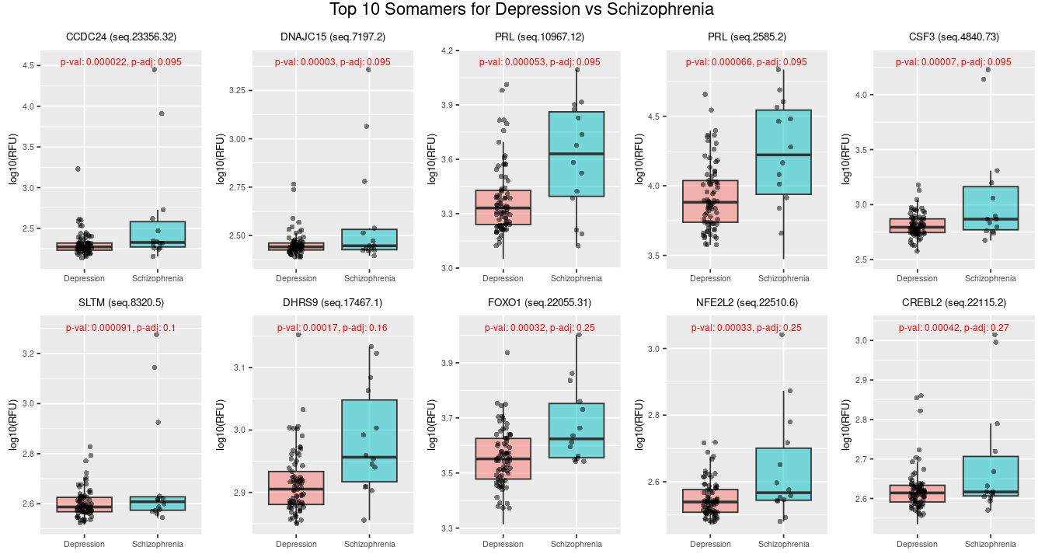
Pairwise comparisons – Depression vs Schizophrenia

Slide 35
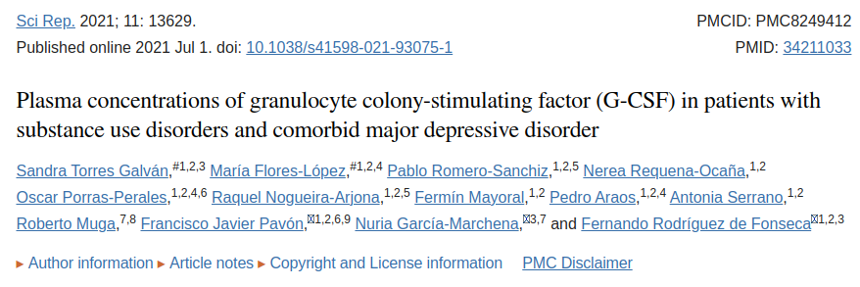
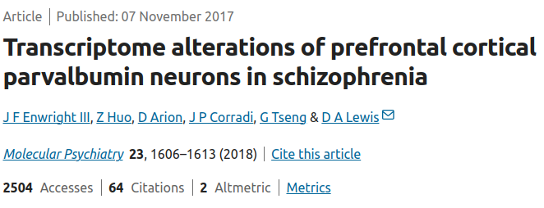
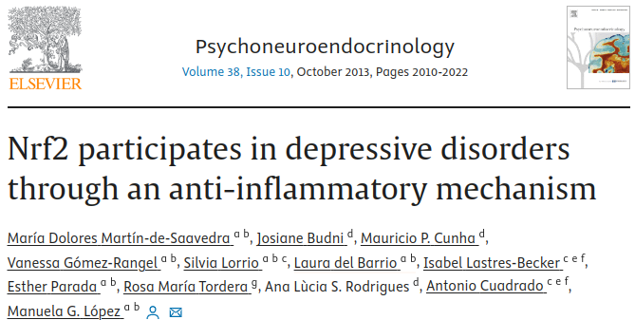
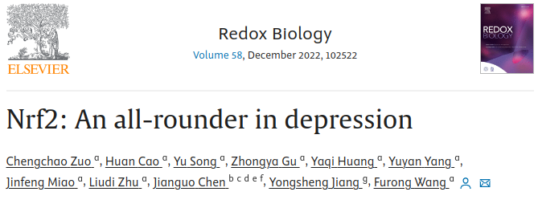
Pairwise comparisons – Depression vs Schizophrenia
Key findings:
CSF3
p=0.0001
Lower in depression
Potential role of G-CSF in MDD disorders associated with substance-use disorders rather than in primary MDD disorders (https://pubmed.ncbi.nlm.nih.gov/34211033/)
DNAJC15
p=0.00012
Higher in Schizophrenia
Differentially expressed in parvalbumin neurons in Schizophrenia (https://www.ncbi.nlm.nih.gov/pmc/articles/PMC5938166/)
NFE2L2 (NRF2)
p=0.00035
Lower in depression. Major association with depression.
"Chronic inflammation due to a deletion of Nrf2 can lead to a depressive-like phenotype while induction of Nrf2 could become a new and interesting target to develop novel antidepressive drugs." (https://pubmed.ncbi.nlm.nih.gov/23623252/)

Slide 36
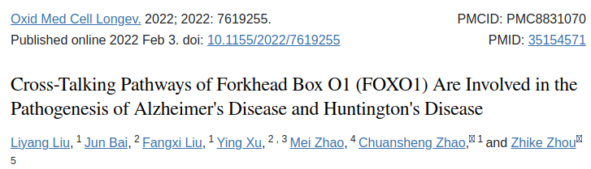
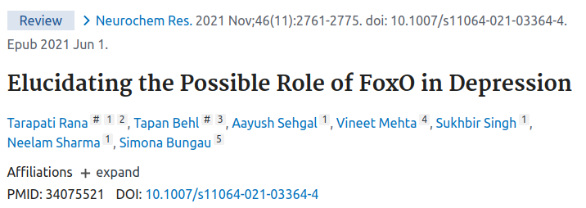
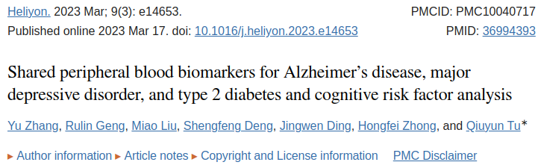
Pairwise comparisons – Depression vs Schizophrenia
Key findings:
FOXO1
Lower in depression
Linked to AD and HD (link)
FoxO family linked to depression (link)
CREBL2
Higher in Schizophrenia
Upregulated in AD, MDD, and T2DB compared to normal controls (link)

Slide 37
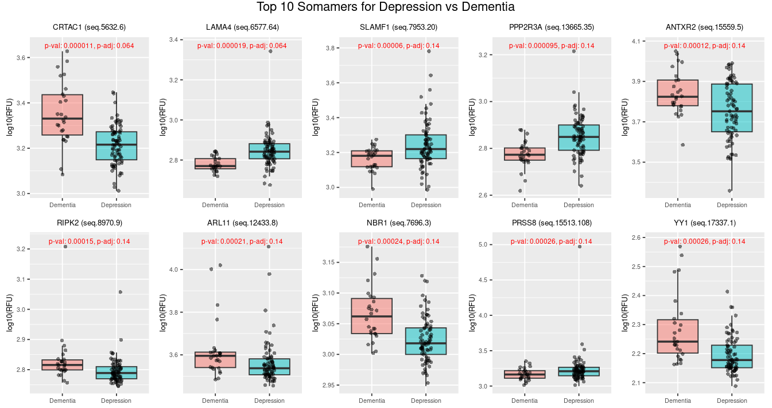
Pairwise comparisons – Depression vs Dementia

Slide 38

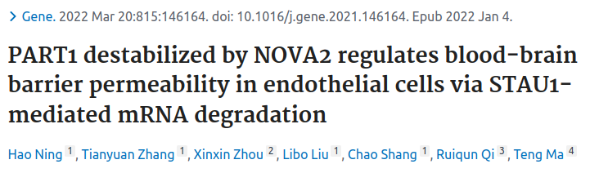
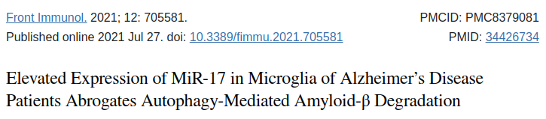
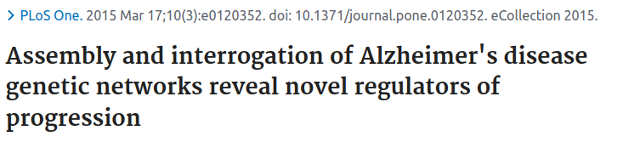
Pairwise comparisons – Depression vs Dementia
Key findings:
SLAMF1
Lower in dementia
SLAMF1 SNP assoc. with memory decline:
"rs13374761-A also had protective effects on global cognition (p = 0.024), episodic memory (p = 0.024), and semantic memory (p = 0.042), and exerts protection against a decrease in CSF Aβ42 concentration (p = 0.0463) and an increase in Aβ loading in cerebral cortex (p = 0.00666) among minor allele carriers" (link)
PPP2R3A
Lower in dementia
"Knockdown of either NOVA2 or PPP2R3A and overexpression of PART1 all increased blood-brain barrier permeability" (link)
RIPK2
Higher in dementia
"RIPK2 profoundly contributes to post-stroke neuroinflammation" (link)
ARL11
Lower in depression
Previously found to be upreg. in MDD (link)
NBR1
Higher in dementia
"We demonstrate in healthy microglia that autophagy cargo receptor NBR1 is required for Aβ degradation" (link)
YY1
Higher in dementia
YY1 is heavily involved in neuronal development and regulation (link)
YY1 protein degradation was detected in the brains of Alzheimer’s disease patients (link)

Slide 39
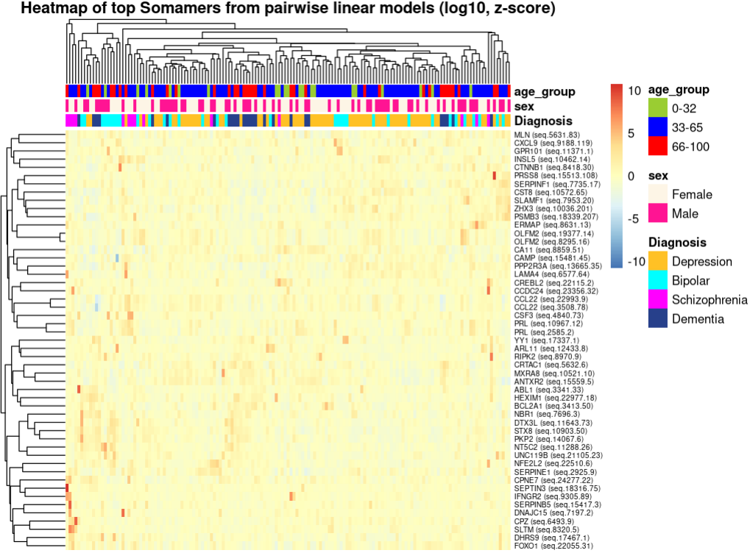
Pairwise comparisons using linear regression
Heatmap of top 10 somamers from each pairwise regression analysis (51 unique somamers)

Slide 40
Conclusions
SomaLogic data is of high quality
Even with underpowered study, we identify a number of biologically relevant differentially abundant proteins when comparing MDD, Schizophrenia, Bipolar disorder, and Dementia.

